Slide 1
PrintNet T Triple Suite
Record Filter & Data Filter

Slide 2

Record Filter
Selects records from the Data File
Based on Record number from a file
    Type in Ranges
    Use a Data File

Slide 3
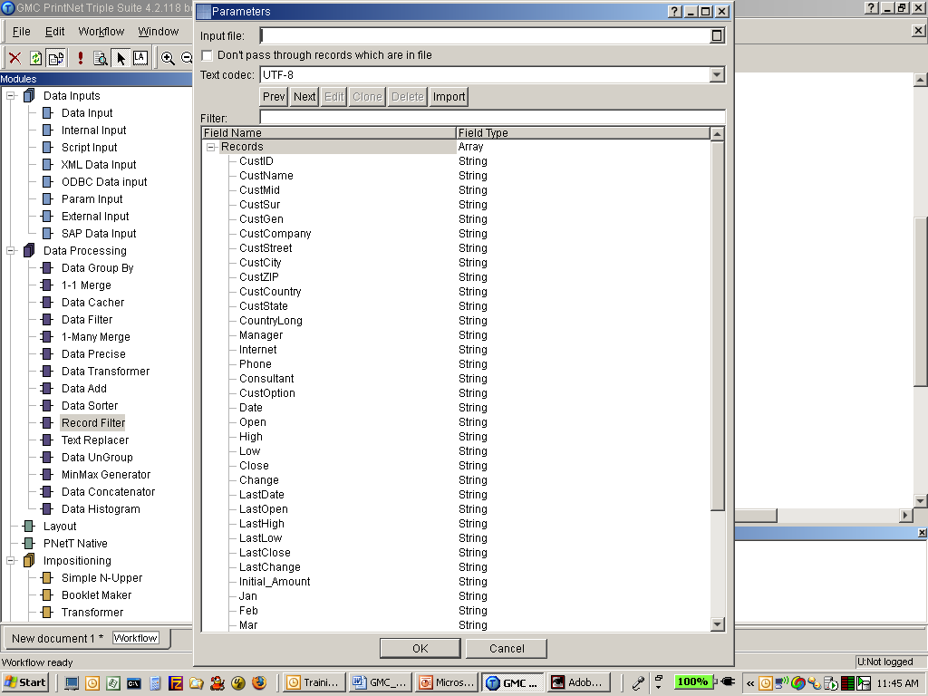
Record Filter
Input file
Filter ranges
Don’t pass through records which are in file

Slide 4
Input File option
Standard text file
Each line contains 1 record number
1st record in file is Record number 0
Text file can be built by Error Recovery System
Notes:
Error recovery mentioned earlier

Slide 5
Filter ranges option
1st Record number is 0
Filter ranges can use semi-colons and dashes
    Example: 1;3;5;100-200

Slide 6
Don’t Pass Through option
An Invert or “Not” option
Allows all records not in the list or text file to pass through

Slide 7
Examples of use
Statement Processing
    Used with Error Recovery to review and reprint “Invalid” reports
100% Mailing
    Remember that the text file is Record Numbers for the file, not unique records

Slide 8
Data Filter
Passes (or keeps from passing) data matching specified criteria.
Provides the capability to select only the input data you want to process.

Slide 9
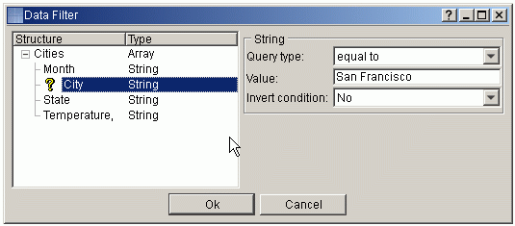
Set-up
Field highlight
Query type.
Value.
Invert conditions
Notes:
Highlight the field in the structure that will be used to select the data.
From the Query type drop-down box on the right, select the query type.
Enter the Value by which you want to filter the data.
Indicate whether you want to Invert condition. (An inverted condition passes everything but
the entered value)
Repeat steps 1 through 4 if you have additional fields you wish to filter.
If there are more complex conditions it is better to use Data Transformer and then Data Filter.

Slide 10

Any questions? Thank You.

